Slide 1

Aviation Fatalities Machine Learning in R IST 707 DATA ANALYTICS
Dr Gates
Editt
Maria
Bhavya
Veasna

Slide 2
Agenda
Introduction
Problem Statement
Objective, Analysis & Result
Clustering
Associate Rule Mining
Decision Tree
Support Vector Machine
Conclusion

Slide 3
Introduction
Rising aviation accidents that involves faulty craftsmanship, pilot errors and systems errors led our individual curiosity
Data is based on NTSB harnessing Data Science methodologies to investigate aviation crashes

Slide 4
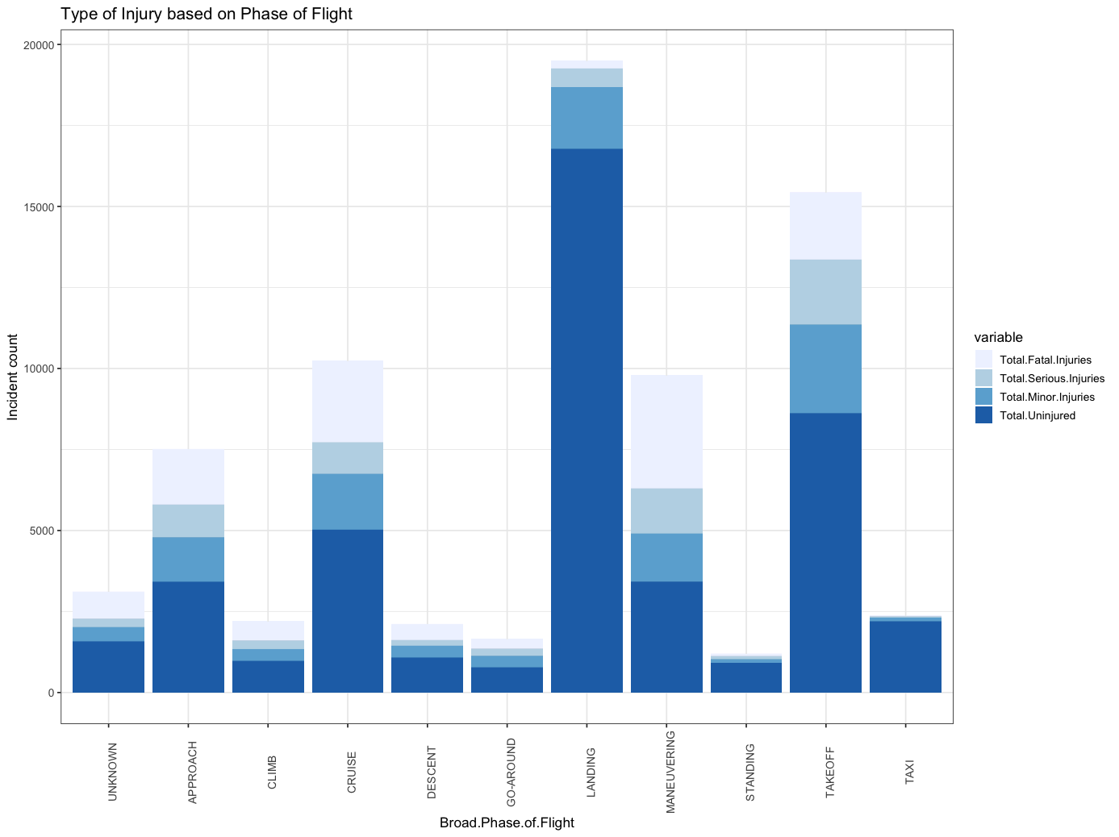
Problem Statement
Investigate commonalities among accident fatalities:
Possible examples:
Bad weather conditions
Pilot Error
Mechanic Failure
Other causes
NTSB data consists of approximately ~84k observations & 32 variables (numeric, nominal, ordinal)

Slide 5
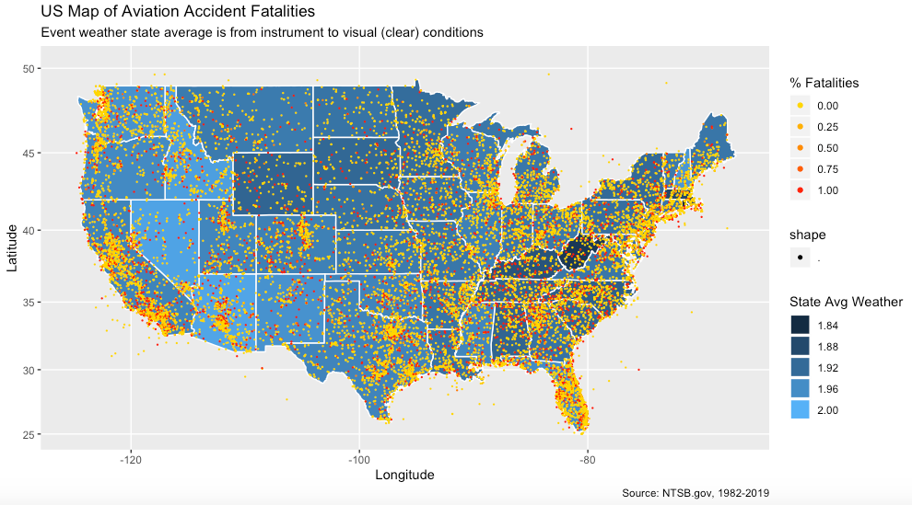
Data Visualization

Slide 6
Clustering ANALYSIS & MODEL
Objective
To identify what characteristics are there for fatal accidents, and if we can identify distinct clusters in our data
Process
Perform K-Means cluster analysis; Challenge: categorical attributes
Tuning
Perform Principal Component Analysis to reduce dimensionality; perform hierarchical clustering to find more insights; tune number of clusters

Slide 7
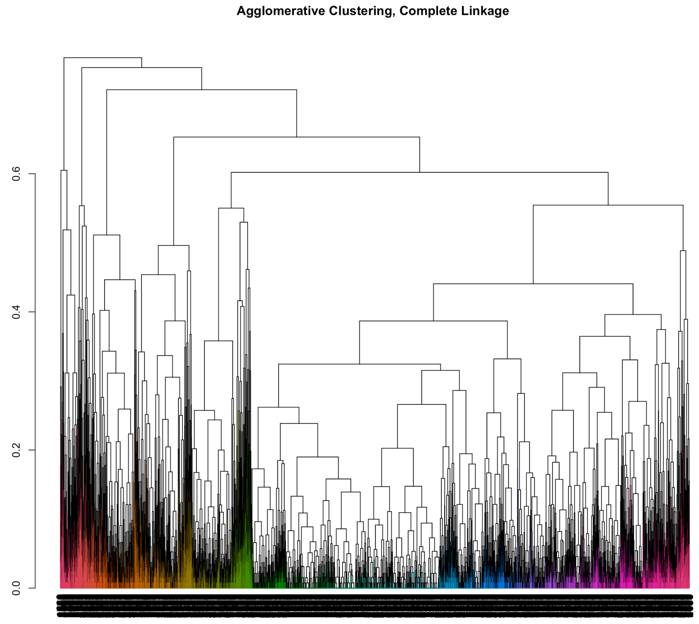
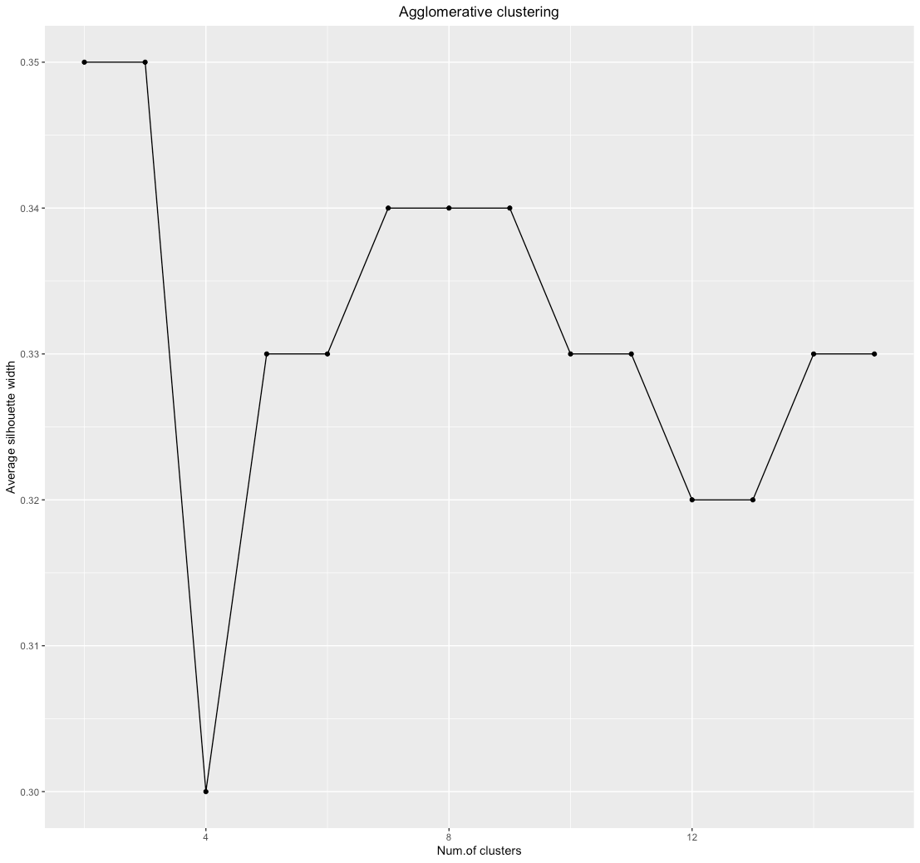
Visual
Hierarchical
Hierarchical clustering recommends 3 or 7 clusters

Slide 8
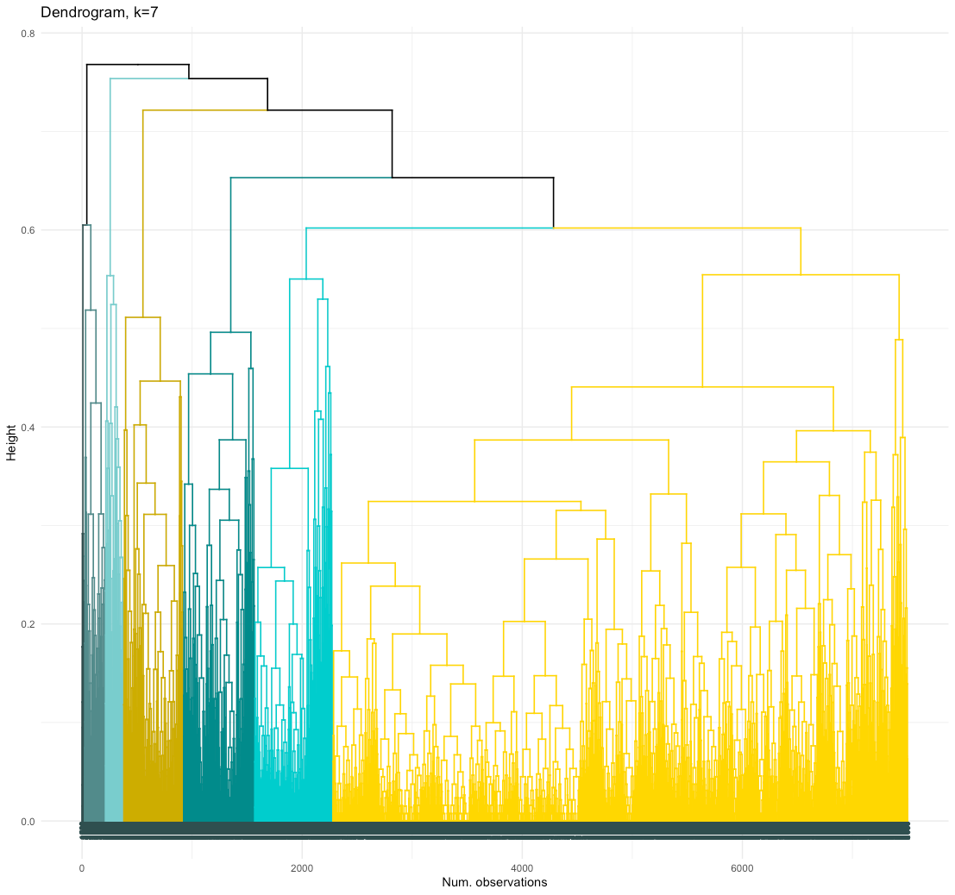
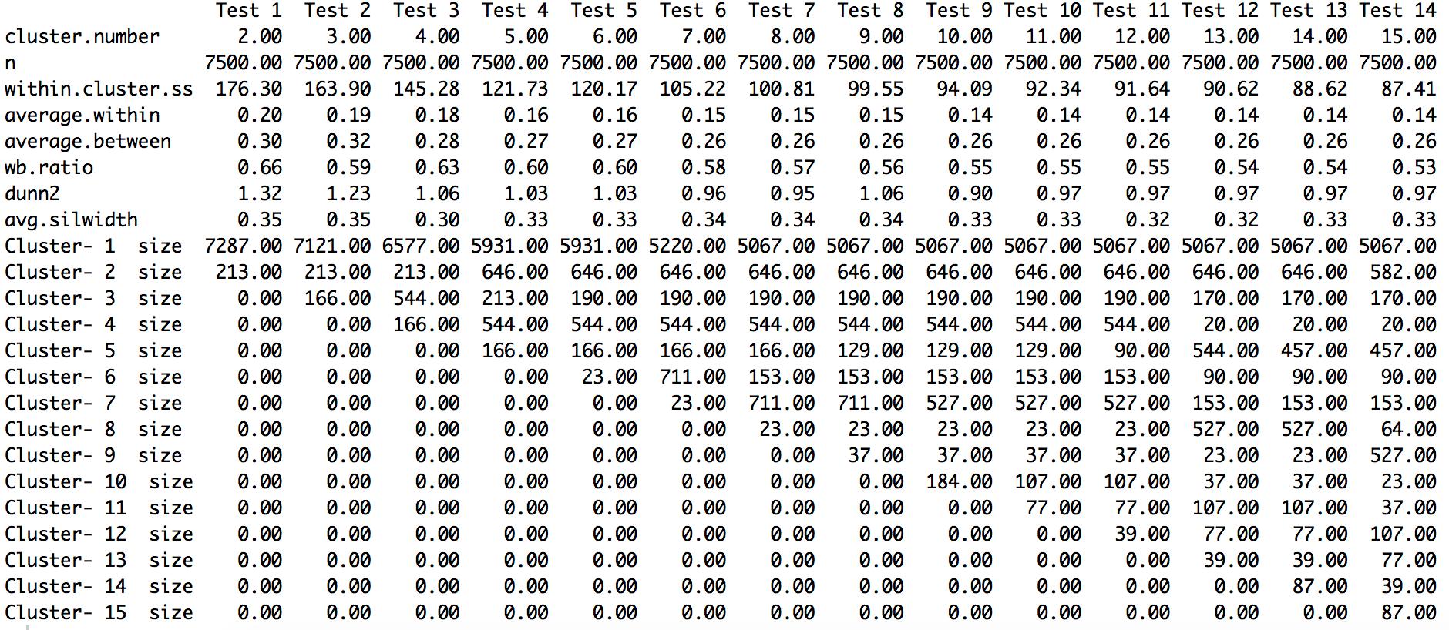
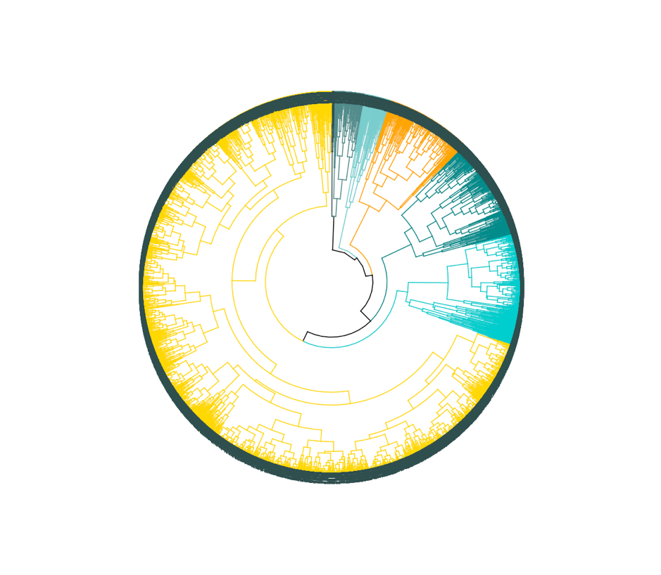
Visual

Slide 9
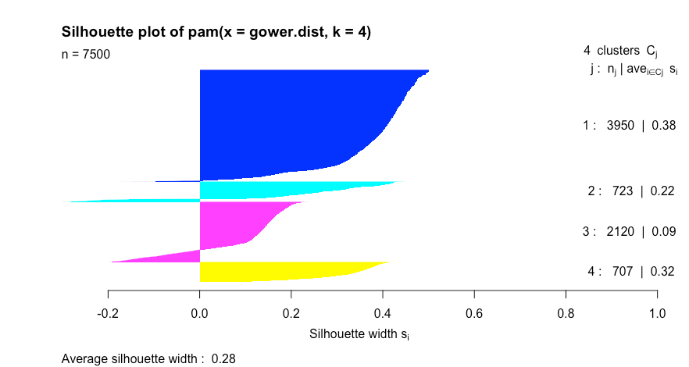
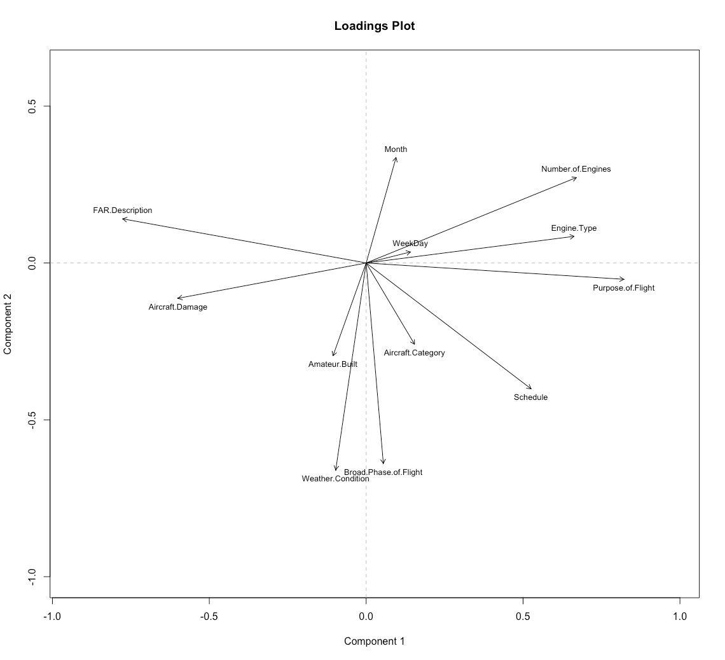
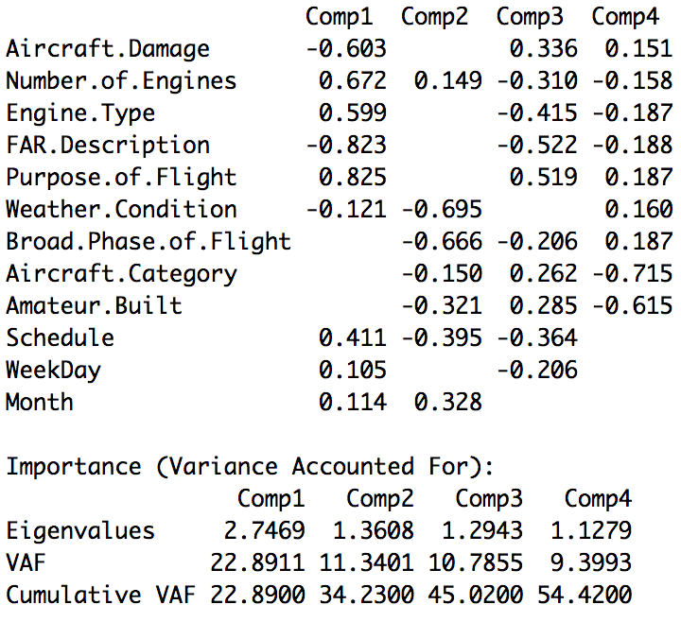
Visual
PCA helps explain what’s in each component

Slide 10
Association Rule Mining ANALYSIS & MODEL
Objective:
To find the probability of relationship between injury severity (Fatal) and various other attributes
Process:
Two iterations with two sets of attributes
Tuning:
Tuned support and confidence to arrive at meaningful rules

Slide 11
Association Rule Mining ANALYSIS & MODEL
Iteration 1 (15 Rules) | Injury Severity = Fatal Lift 3.8 - 4.1
Injury Severity | Amateur Built = No Weather Condition = Instruments Phase of Flight = MANEUVERING 375 Aircraft Category = Airplane Weather Condition = Instruments Phase of Flight = MANEUVERING 371 Purpose of Flight = Private Weather Condition = Instruments Phase of Flight = CRUISE 814
Aircraft Category
Amateur Built
Schedule
Purpose of Flight
Weather Condition
Phase of Flight

Slide 12
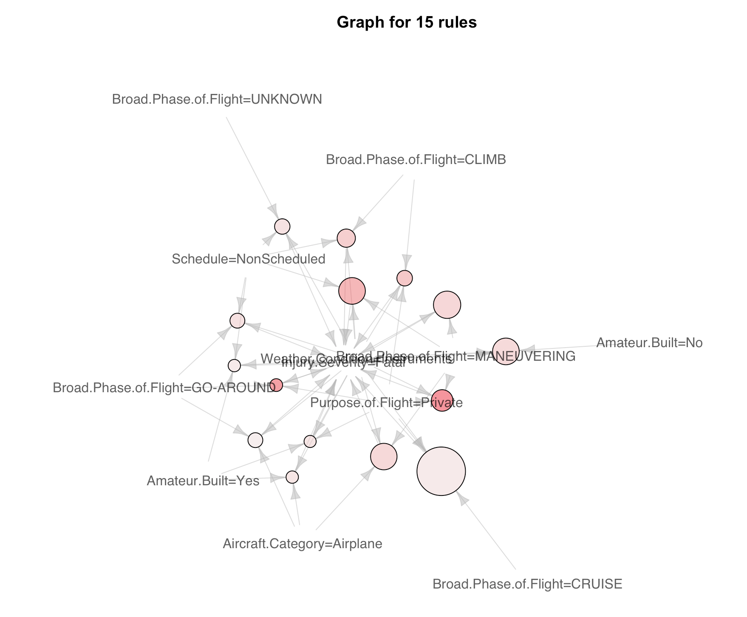
Visual

Slide 13
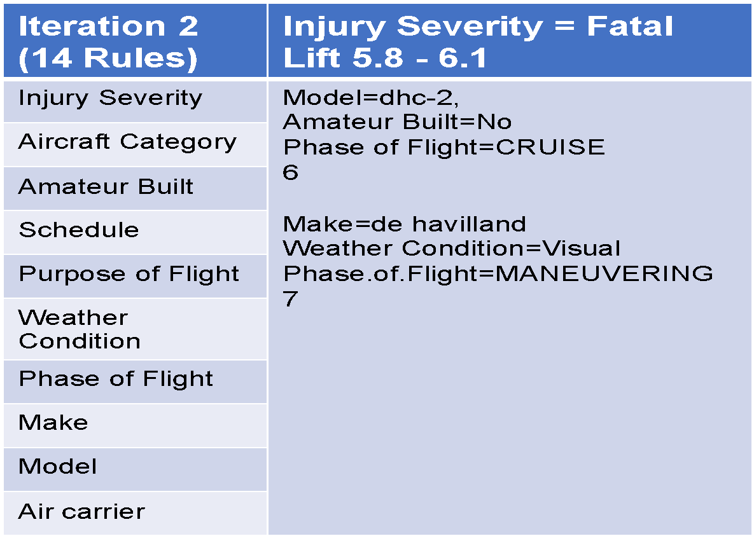
Association Rule Mining ANALYSIS & MODEL

Slide 14
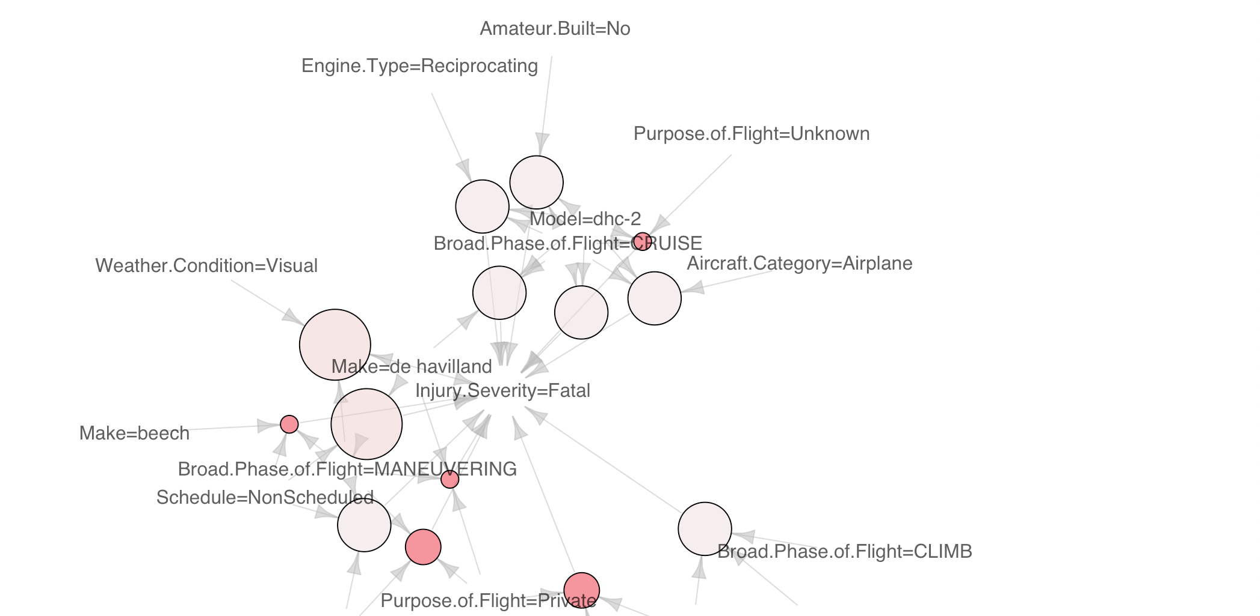
Visual

Slide 15
Decision Tree ANALYSIS & MODEL
Factor | Model Accuracy
Injury.Severity | 99.4%
Aircraft.Damage | 86.3%
Aircraft.Category | 97.2%
Amateur.Built | 89.8%
Number.of.Engines | 89.9%
Engine.Type | 89.8%
FAR.Description | 97%
Schedule | 96.9%
Purpose.of.Flight | 67.9%
Total.Fatal.Injuries | 99.9%
Total.Serious.Injuries | 93.8%
Total.Minor.Injuries | 92.2%
Total.Uninjured | 94.3%
Weather.Condition | 92.8%
Broad.Phase.of.Flight | 36.9%
Month | 12.2%
Purpose:
To identify a model with a high accuracy for prediction of injury severity
Process:
Training data (2/3) & testing data (1/3)
Evaluate model accuracy by each factor
Tuning
Cross reference with associate rules
Combine factors with model accuracy > 95%

Slide 16
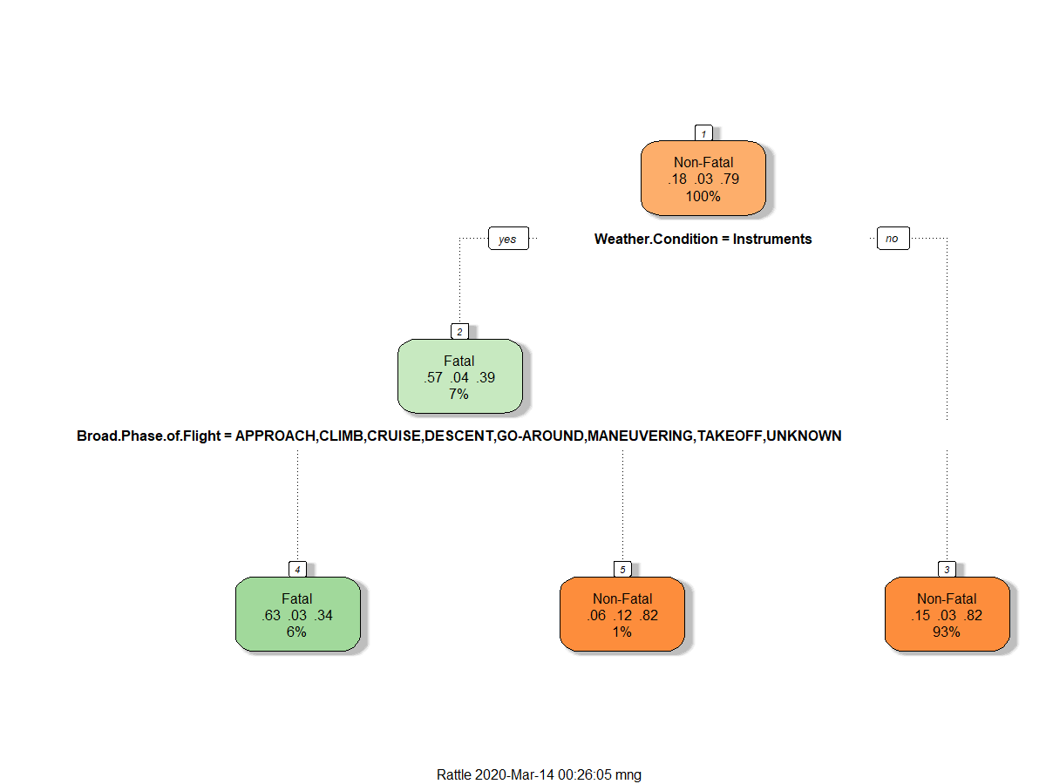
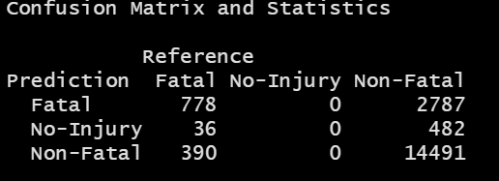
Visual - cross reference with association rule
Association Rule #1
{Weather.condition = Instruments, Broad.Phase.of.Flight = Maneuvering} → {Injury.Severity = Fatal}
Model Accuracy: 80.5%

Slide 17
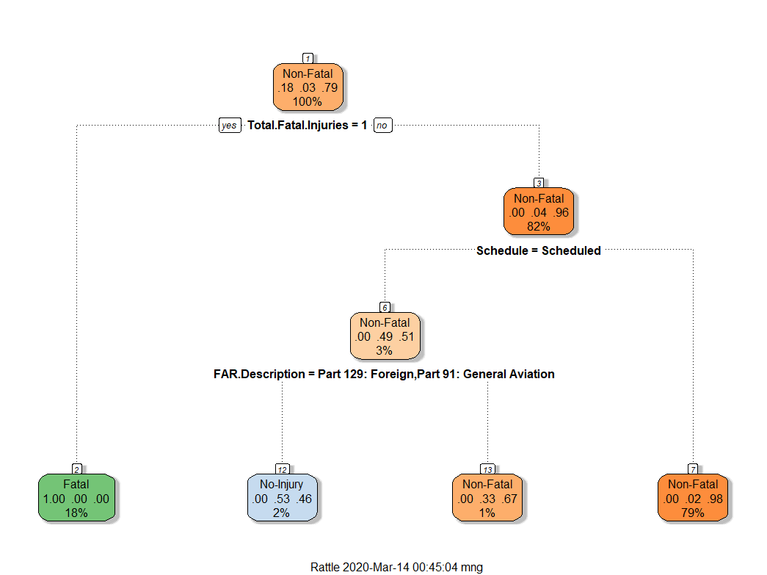
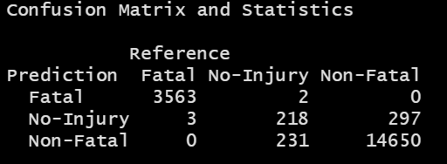
Visual - combined factors / tuning
Select factor with model accuracy > 95%:
Total.Fatal.Injuries, Schedule, Aircraft.Category, and FAR.Description
Model Accuracy: 97.2%

Slide 18
Support Vector Machine ANALYSIS & MODEL
Objective
Given a set of attributes to predict the target attribute: “Fatal” or “Non-Fatal”
Process
Injury Severity, Built, Engine Type & Count, Flight Purpose, Weather Conditions, etc
Intuition and Correlation of choosing attributes
Transform nominal data to numeric for SVM algorithm
Compare different kernels
Tuning
Using 10-fold Cross-validation, Kernel, Cost and Gamma

Slide 19


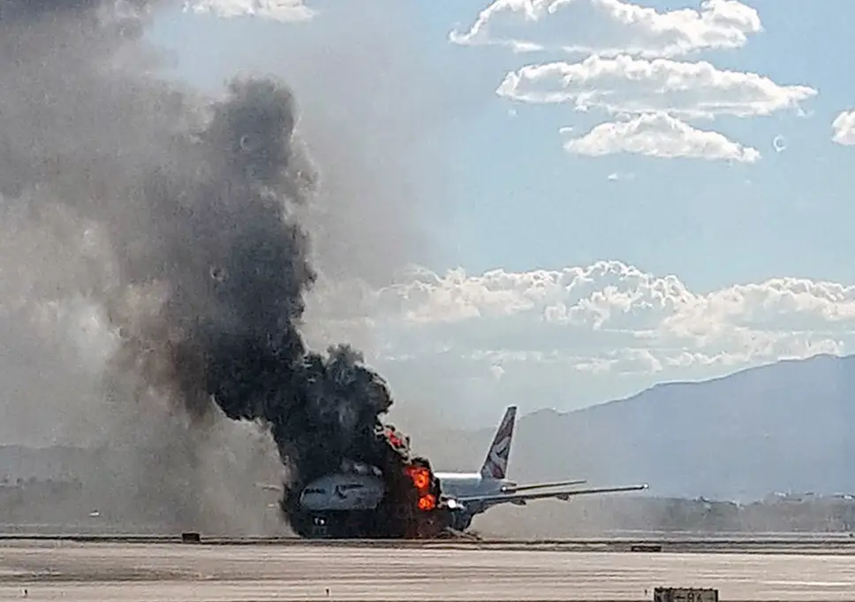


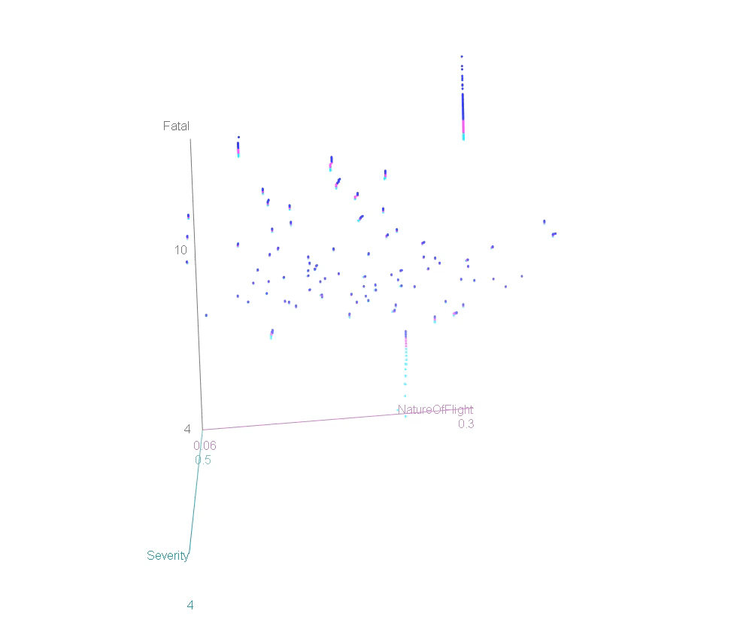
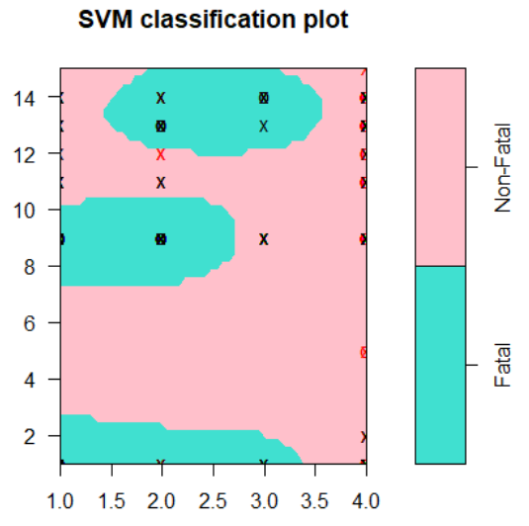
Visual

Slide 20
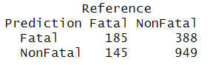
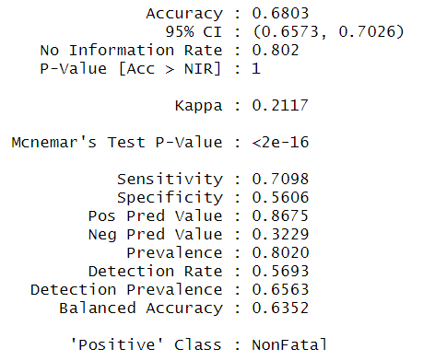
Support Vector Machine RESULT

Slide 21
Conclusion
Machine Learning
Unsupervised | Association Rule Mining | {Amateur Built = No, Weather Condition = Instruments, Phase of Flight = MANEUVERING} → {Fatal Injury}
 | Clustering | Important Variables: FAR.Description, Weather Condition, Phase of Flight, Purpose of Flight
Supervised | SVM | Model accuracy 68% (10-fold cross validation)
 | Decision Tree | Model accuracy 97% (3-fold cross validation)

